Slide 1
Windows Azure SQL Database - Basic

Slide 2
Agenda
Architecture of Windows Azure SQL Database
Feature Comparison between Windows Azure and Windows Server versions
Other Cloud databases
Lab: Using SQL Server Management Studio to Provision, Build, Deploy and Secure a Windows Azure SQL database

Slide 3




Windows Azure SQL Database The first and only true relational database as a service
Self-managed
Elastic Scale
Developer Agility
Easy provisioning and deployment
Auto high-availability and fault tolerance
Self-maintaining infrastructure; self-healing
No need for server or VM administration
Database utility; pay as you grow
Flexible load balancing
Business-ready SLAs
Enable multi-tenant solutions
World-wide presence
Build cloud-based database solutions on consistent relational model
Leverage existing skills through existing ecosystem of developer and management tools
Explore new data application patterns

Slide 4
Network Topology
Application
Applications use standard SQL client libraries: ODBC, ADO.Net, …
TDS (tcp:1433)
Load Balancer
Load balancer forwards ‘sticky’ sessions to TDS protocol tier
TDS (tcp: 1433)
Gateway
Gateway
Gateway
Gateway
Gateway
Gateway
TDS (tcp: 1433)
Data Node
Data Node
Data Node
Data Node
Data Node
Data Node
Scalability and Availability: Fabric, Failover, Replication and Load balancing

Slide 5
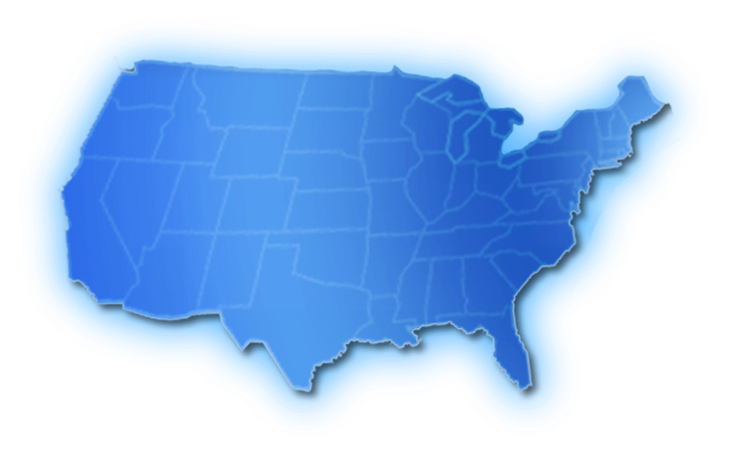





Performance Considerations
The distance your application travels to perform data access will affect performance
Redesign your application for fewer trips to the database
Use the same Data Center for all components of your application

Slide 6
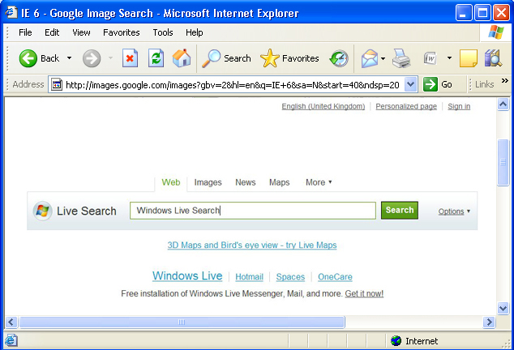


Application Topologies
From Windows Azure
From Outside Microsoft Datacenter
From Windows Azure & Outside Microsoft Datacenter
SQL Server
Application/Browser
App Code / Tools
App Code / Tools
ADO.NET Data Svcs/REST - EF
HTTP/S
SOAP/REST
HTTP/S
SQL
Data Sync
Windows Azure
Microsoft Datacenter
Microsoft Datacenter
Windows Azure
Microsoft Datacenter
T-SQL (TDS)
T-SQL (TDS)
T-SQL (TDS)
SQL DB
SQL DB
SQL DB
Code Near
Code Far
Hybrid

Slide 7

Data Hub
“An aggregation of Enterprise, Partner, Desktop, and Device data within Windows Azure SQL Database”
Windows Azure
Enterprise
Azure App
On-premises App
ADO.NET, ODBC, …
Windows Azure SQL Database
Data Sync Service
Enterprise
Sync
Sync
Sync
User Management
Device Management
Desktop
Device
Sync Gateway
Client App
Client App
Business Logic / Rules
Sync Client
Sync Client

Slide 8



Service Provisioning Model
Account
Each account has zero or more servers
Azure wide, provisioned via a common portal
Establishes a billing instrument
The servers are logical, not tied to physical machines
Each server has one or more databases
Logical concept equal to a master DB
Contains metadata about database & usage
Unit of authentication, geo-location, billing, reporting
Generated DNS-based name
Each database has standard SQL objects
Users, Tables, Views, Indices, etc.
Unit of consistency
Server
Database
Notes:
It is important to clarify that logical servers are not tied to physical machines, meaning the logical server is really just a unit of organization (you have a logical master database with data for the databases on the “logical server”).

Slide 9

Database Replicas and Failover
!
Three Replicas
Replica 1
Single Primary
Single Database
Replica 2
DB
Replica 3
Replica 4
Notes:
This slide shows what happens when a primary fails. Clarify that there are a bunch of primary / secondaries on each machine (other databases on the cluster).

Slide 10




Windows Azure SQL Database Deployment
DB Script
SQL Azure
TDS Gateway

Slide 11
Windows Azure SQL Database Accessing databases
Change Connection String
Your App
Windows Azure SQL Database
TDS Gateway

Slide 12
Connecting to Windows Azure SQL Database
Connect via Entity Framework, ADO.NET, ODBC, etc.
OLE DB provider is NOT supported
May need to include <login>@<server>
Attaching a database is NOT supported
Use familiar tools (sqlcmd, osql, SSMS, etc)
Use SQL Server Management Studio 2008 R2 / 2012

Slide 13
Windows Azure SQL Database Security
Supports SQL Server Security
On-premise SQL Server security concepts still apply
Server-level: sds_dbcreator, sds_securityadmin roles
Database-level: same as on-premise SQL Server
Administrative user is equivalent to sa

Slide 14


Database Editions
Two SQL Database SKUs: Web & Business
You specify Web or Business Edition
Web: EDITION = Web
Business: EDITION = Business
You specify MAXSIZE
Web: MAXSIZE = 100MB | 1GB | 5GB
Business: MAXSIZE = 10GB | 20GB | 30GB | 40GB | 50GB | 100GB | 150GB
This is the size Microsoft will not let you grow beyond
You will be charged for the actual (peak) size (in any one day)
CREATE DATABASE foo1 (EDITION='business', MAXSIZE=50GB);
CREATE DATABASE foo2 (EDITION='business', MAXSIZE=30GB);
CREATE DATABASE bar1 (EDITION='web', MAXSIZE=5GB);
CREATE DATABASE bar2 (EDITION='web'); -- Defaults to 1GB
Business Edition
Up to 150 GB
Web Edition
Up to 5 GB

Slide 15
Migrating Databases
“Just change the connection string” * once database is migrated
SQL Server Management Studio 2012 has increased support for Windows Azure SQL Database
Migrating Databases Hands On Lab in the Windows Azure Training Kit
Notes:
Explain that Database Migration has to take into account the increased communication time (build retry logic) and maximum DB size limit, currently 150 GB (Scale Out).

Slide 16
Moving data
Scripted INSERT statements
SQL Server Integration Services
BCP (bulk copy) is supported
SQL Data Sync

Slide 17
Quiz
Q: How many types of Database Editions are available in Windows Azure?
1
2
3
4
Ans: Two – Web and Business

Slide 18
Demo: Show how to create a new database in the management portal
demo

Slide 19
Windows Azure SQL Database and SQL Server
Feature Comparison and Special Considerations

Slide 20
Management
Core management functions handled by Microsoft:
Physical Administration
Patching
Security
Scale and functionality of an enterprise data centre without the administrative overhead
Enables organizations to provision data services within minutes
Provision only what is needed, when it is needed
Pay only for what is used – Capital Expenditure replaced by Operational Expenditure

Slide 21
High Availability
Windows Azure SQL Database provides High Availability as standard for every database
Automatically handles variations in usage and load
Replicates multiple redundant copies to multiple physical servers to maintain data availability and business continuity
In case of a hardware failure, provides automatic failover to ensure availability for applications

Slide 22
On-Demand Scalability
Ease of Scaling – takes just minutes to scale up to a bigger maximum size
Scaling up has Iimits, scale out can be implemented easily – has no virtual limits
Data-partitioning / Sharding, the most common technique for Scaling Out, is supported (Details in the next lecture)
Scaling Down the service when you do not need it is equally simple and quick

Slide 23
Database Size Limits
Maximum single database size is currently 150GB
Database size calculation
Includes: primary replica data, objects and indexes
Does NOT include: logs, master database, system tables, server catalogs or additional replicas
SQL Server has practically no limits on database size

Slide 24
Connectivity and Authentication
SQL Server Management Studio (2008 R2 or later) can be used to handle both
Windows Azure SQL Database supports only SQL Authentication
SQL Server also supports Windows Authentication

Slide 25
Throttling
MSDN
Use traditional SQL Server best practices
Build in retry logic especially if you expect very high throughput demands
Consider scaling out for high throughput scenarios

Slide 26
Schema Limitations
Windows Azure SQL Database does not support heaps
ALL tables must have a clustered index before data can be inserted
If a table is created without a clustered constraint, a clustered index must be created before an insert operation is allowed on the table.

Slide 27
T-SQL Support (full or partial)
Constants
Constraints
Cursors
Index management and rebuilding indexes
Local temporary tables
Reserved keywords
Stored procedures
Statistics management
Transactions
Triggers
Tables, joins, and table variables
Transact-SQL language elements such as
Create/drop databases
Create/alter/drop tables
Create/alter/drop users and logins
…
User-defined functions
Views

Slide 28
T-SQL Not Supported
Common Language Runtime (CLR)
Database file placement
Database mirroring
Distributed queries
Distributed transactions
Filegroup management
Full Text Search
Global temporary tables
SQL Server configuration options
SQL Server Service Broker
System tables
Trace Flags

Slide 29
Not available in the Cloud
“USE” Command for switching databases
As different databases can be on different servers, an application must directly connect to different databases
Transaction Replication
If needed, use SQL Data Sync
Log Shipping
Database Mirroring

Slide 30
Not available in the Cloud
SQL Agent
If needed, can be run on on-premises SQL server and connect to Windows Azure SQL Database
Server Options
As physical management is looked after by Microsoft, most system level metadata is disabled as it does not make sense in a cloud model to expose server level information to users
SQL Server Integration Services
If required, run SSIS on site and connect to SQL Azure with ADO.NET provider

Slide 31
The Fundamental Difference
Windows Azure SQL Database is a Service, managed by Microsoft
SQL Server is a Database Server, managed by you
Therefore, functionality related to physical administration / physical machine access is not available in SQL Database

Slide 32
Other Cloud Databases
Relational and
Non-Relational

Slide 33
Amazon RDS
Relational
Familiar SQL syntax
Full capabilities of MySQL 5.1 / 5.5 Community Edition
Support for Oracle 11gR2 and SQL Server 2008 R2
Can be bundled as part of EC2 IaaS offering for flexibility
Scalability options for SQL Server yet to mature

Slide 34
Google BigQuery
Non-Relational, Unstructured
Web service for querying large datasets
Very fast execution of select-and-aggregate queries on tables with billions of records
Scalable
SQL like syntax
Google Storage is the persistent mechanism
Does not currently support joins
Access control only at the level of datasets, not to tables. Anyone with access to a dataset has access to all tables within that dataset

Slide 35
Amazon SimpleDB
Non-relational, highly available, scalable and flexible data store
Offloads the work of database administration
Store and query via web services requests
Data access very simple
All information stored in domains – domains are similar to tables that contain similar data

Slide 36
Amazon SimpleDB (cont.)
Not suitable for Enterprise / large data applications
Can execute queries against a domain, but cannot execute joins between domains
Limited Locking and Performance tuning options
Designed to store relatively small amounts of data - Strict storage limitation of 10 GB per domain
Limited request capacity, typically under 25 writes/second

Slide 37
Hadoop
Non-relational
Programs must be written to conform to the “MapReduce” programming model
Simple, but new, programming model
Designed for Very large scale – 100s of GB is the starting point
Automatic distribution of data and work
Not suitable for typical data sets

Slide 38
Quiz
Q: Which of the following Cloud Databases are Relational Azure?
Hadoop
Windows Azure SQL Database
Amazon Simple DB
Google BigQuery
Ans: Windows Azure SQL Database

Slide 39
Further Reading
How to use SQL Database in .NET applications is described at: http://www.windowsazure.com/en-us/develop/net/how-to-guides/sql-database/

